Slide 1
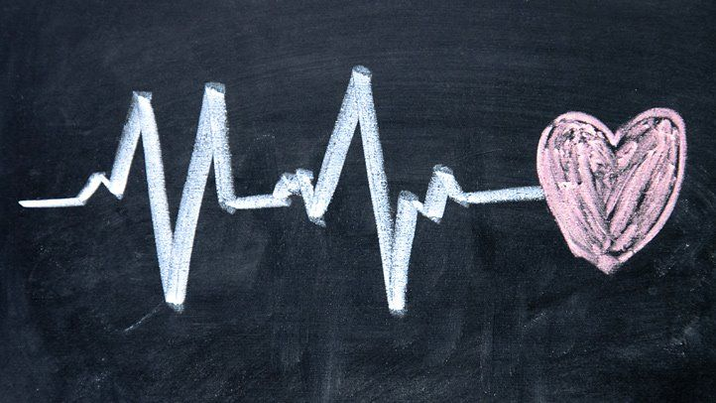



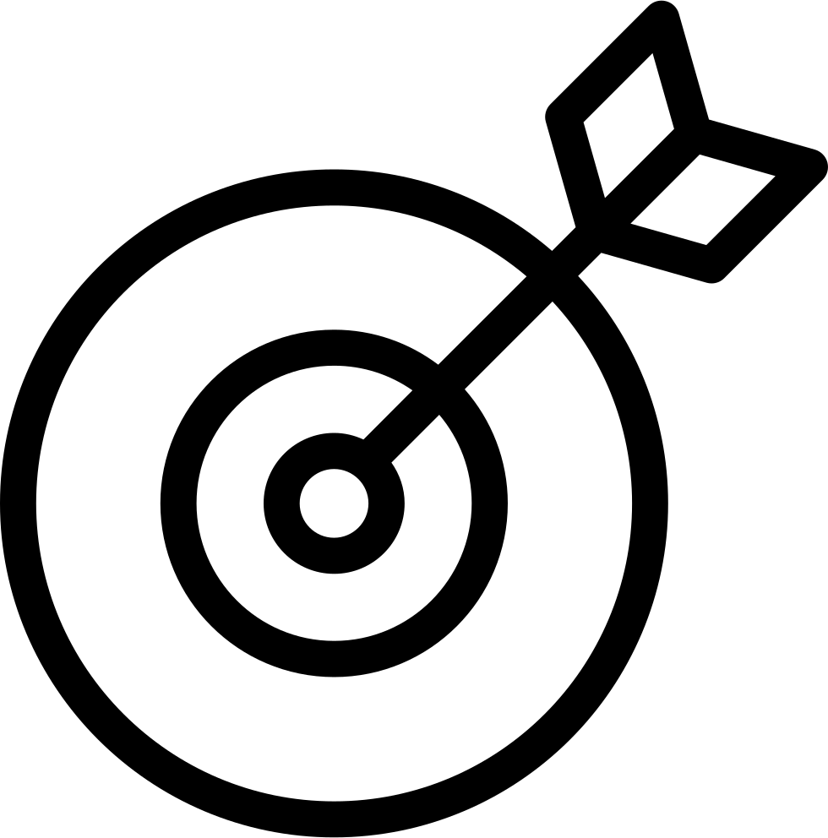
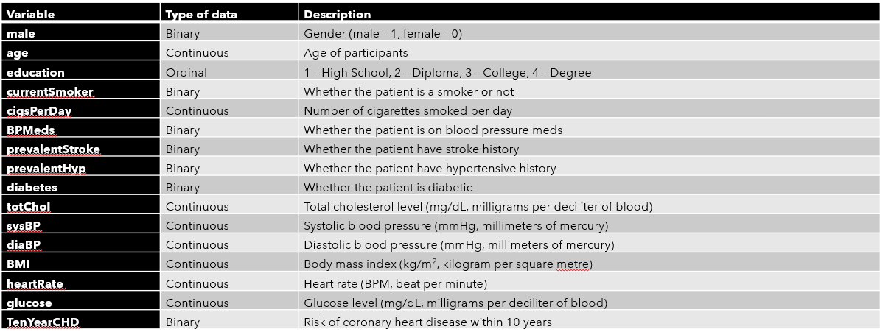
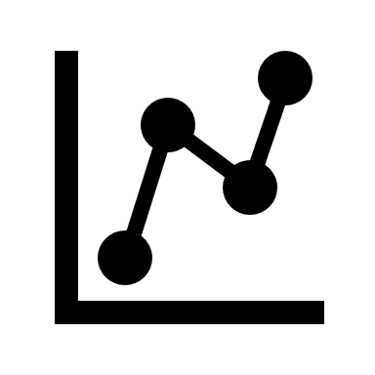
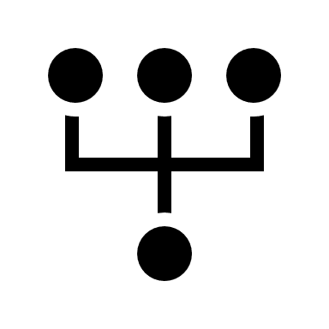
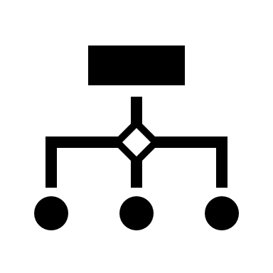
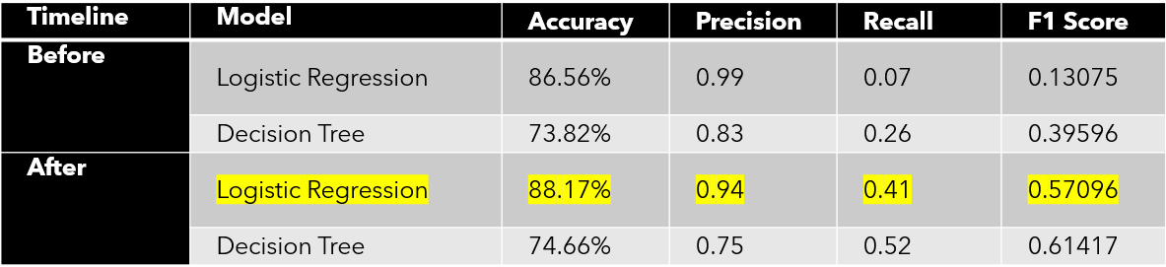
Heart Diseases Prediction Using Machine Learning Approach
by Timothy Chen Xian Yii
Supervisor: Dr. Gan Chew Peng
INTRODUCTION
OBJECTIVE
Cardiovascular diseases (CVDs) are a group of disorders of the heart and blood vessels which includes coronary, congenital, cerebrovascular etc.
According to World Health Organization:
CVDs are the leading cause of death globally.
An estimated 17.9 million people died from CVDs in 2019, representing 32% of all global deaths. Of these deaths, 85% were due to heart attack and stroke.
Out of the 17 million premature deaths (under the age of 70) due to noncommunicable diseases in 2019, 38% were caused by CVDs.
Machine learning can be defined as a branch of computer science and artificial intelligence which uses algorithms and data to imitate a human’s thought process and improving its accuracy in analyzing and carrying out specific task (IBM, 2021). This allows the creation of predictive models which can help predict a patient's potential risk of heart disease when humans could not.
Perform data cleaning and pre-processing to eliminate any missing values and discrepancies in the data. | Conduct detailed data analysis on the data provided to find out the most prevalent factor in heart diseases with the aid of relevant analytics software. | Comparing the accuracy and accessibility of the model among various machine learning techniques with varying conditions.
METHODOLOGY
The dataset used in this research is from a heart study which was conducted in Framingham. It has a total of 4238 observations with 16 variables in total. The target variable of our dataset is the ‘TenYearCHD” which states whether the respondent will contract any form of heart disease within 10 years lifetime. The following figure shows the description for all the variables inside the dataset.
Any numerical or predictive analysis are performed with using Python as the main programming language. The packages and libraries used in this study are mainly Pandas, sci-kit learn, and imbalanced-learn.
Before moving on to the data modelling, a pre-processing process has to be carried out to remove any discrepancies in the dataset such as missing values, outliers, invalid values etc. Most common method of filling in missing values is imputation.
Furthermore, a splitting process is performed and the dataset is separated into both training and testing dataset, with their respective ratio of 8:2. This is to ensure that the model can be trained by using the training dataset before evaluating and comparing it with the testing dataset.
In this study, Logistic Regression, Decision Tree, and Naïve Bayes are used in our predictive modelling as these three are considered to be often used and can be seen in many researches.
Table 1: Brief Summary of ML Models Used in this Study
Logistic Regression | Decision Tree | Naïve Bayes
A classification algorithm in predicting output which are binary in nature i.e., true/false, pass/fail, win/lose etc. | A branching graph whereby all variables are considered as a node and splitting process is carried out. Evaluated with Gini Index | A derivation of the Bayes theorem with the assumption of independence among the regressors.
The above machine learning models are evaluated by plotting their respective confusion matrix. From there, the accuracy and F1-score can be calculated manually by considering their precision (true negative rate) and recall (true positive rate).
Since this is an imbalanced dataset (number of positive in target variable ≠ number of negative in target variable), resampling methods are considered in this research to improve the final score. Both under-sampling and over-sampling (SMOTE) are used in this research.
Random under-sampling removes examples from the majority class so that it matches with the minority class while SMOTE (Synthetic Minority Over-Sampling Technique) duplicates examples into the minority class based off the majority (Brownlee, 2020).
Fine tuning hyperparameters was introduced later in the research as a backup method in attempting to boost the model’s performance.
Figure 1: Description of the Dataset
RESULT
Table 2: Overall Performance of the ML Models
Figure 2: Comparison of Model Performance Before and After Fine Tuning
ML Model with conditions | Accuracy | F1 Score
Logistic Regression, no resampling | 86.58% | 0.13075
Logistic Regression with random under-sampling | 62.76% | 0.65356
Logistic Regression with SMOTE | 62.73% | 0.62997
Decision Tree, no resampling | 73.82% | 0.39596
Decision Tree with random under-sampling | 55.54% | 0.55146
Decision Tree with SMOTE | 73.94% | 0.38496
Naïve Bayes, no resampling | 80.54% | 0.34125
Naïve Bayes with random under-sampling | 79.83% | 0.42241
Naïve Bayes with SMOTE | 76.65% | 0.48189
Fine tuning hyperparameters are used as an attempt to boost the performance. For Logistic Regression model, the backward elimination is used to remove any insignificant variables in our logistic regression equation and the pruning process is carried out for the Decision Tree model.
Naïve Bayes is excluded in this section as due to parameter limitations (Tokuç, 2021).
The F1 score and accuracy improved, with Logistic Regression showing the most significant improvement.
Overall, the Logistic Regression model is favored more than Decision Tree.
CONCLUSION
Logistic Regression with backward elimination as fine-tuning process performs better overall than the rest of the proposed models in this research.
According to the final model, males have higher risk in contracting heart diseases than females in general and those who have stroke in the past will have a higher chance as well.
Respondents with abnormal range of systolic blood pressure have higher potential in getting heart diseases within 10 years.
A validation dataset can be considered during analysis to boost the model’s performance before model evaluation with testing dataset.
Overall, the performance is not as satisfactory since the F1 score of the above models were not more than 0.8 (value close to 1 is the best).
Due to the loss of information after resampling, it is understandable that the accuracy for all the model decreases after removing some observation. The same goes for over-sampling whereby there is a surplus of information which could overwhelm the model.
Hence, a second method in improving the model is used, which is the process of fine tuning hyperparameters.
REFERENCES
Brownlee, J. (2021, January 5). Random Oversampling and Undersampling for Imbalanced Classification. Machine Learning Mastery. https://machinelearningmastery.com/random-oversampling-and-undersampling-for-imbalanced-classification/
Cardiovascular diseases (CVDs). (2021, June 11). World Health Organization. https://www.who.int/news-room/fact-sheets/detail/cardiovascular-diseases-(cvds)
International Business Machines Corporation. (2021, July 2). What is machine learning? IBM. https://www.ibm.com/my-en/cloud/learn/machine-learning
Tokuç, A. A. (2021, April 24). How to Improve Naive Bayes Classification Performance? Baeldung on Computer Science. https://www.baeldung.com/cs/naive-bayes-classification-performance

